Slide 1
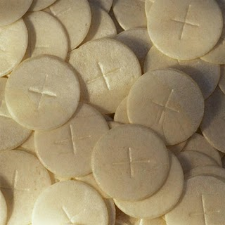
Extraordinary Ministers of Holy Communion
Instruction and Discussion

Slide 2
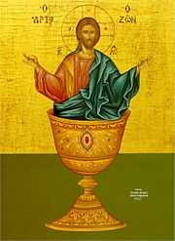
THEOLOGICAL/HISTORICAL PERSPECTIVE
Bishop Thomas J. Tobin
It was in 1971 that extraordinary ministers of the Eucharist were first permitted in the United States. At that time the Congregation of the Sacraments responded to a request of the American bishops to allow laypersons to assist priests in giving Holy Communion.

Slide 3
In January 1973, Pope Paul VI, in the instruction "Immensae Cariatis," extended this permission to the universal Church. He wrote "Present-day conditions demand that greater access to Holy Communion should be made possible so that the faithful, by sharing more fully in the fruits of the sacrifice of the Mass, might dedicate themselves more readily and effectively to God and to the good of the Church First of all, provision must be made lest reception become impossible or difficult owing to a lack of a sufficient number of ministers."

Slide 4
RESPONSIBILITY/PURPOSE
"Extraordinary ministers may distribute Holy Communion at eucharistic celebrations only when there are no ordained ministers present or when those ordained ministers present at a liturgical celebration are truly unable to distribute Holy Communion. They may also exercise this function at eucharistic celebrations where there are particularly large numbers of the faithful and which would be excessively prolonged because of an insufficient number of ordained ministers to distribute Holy Communion." ("Instruction on Certain Questions Regarding the Collaboration of the Non-Ordained Faithful in the Sacred Ministry of Priests")

Slide 5
SELECTION/DISCERNMENT
Extraordinary ministers are to be fully initiated Catholics, at least 16 years of age, who lead a life in harmony with the undertaking of this ministry including participating in the sacramental life of the Church. The pastoral staff, Liturgy Committee, and/or Parish Council may assist the pastor in discerning parishioners to fulfill this ministry. Persons who themselves express a desire to become an extraordinary minister of the eucharist should be carefully considered.

Slide 6
FORMATION/TRAINING
A time of formation to deepen their understanding of the eucharist and the ministry they are to undertake should be provided for extraordinary ministers of the eucharist. A portion of this formation may be offered for all liturgical ministers at the same time thus enabling them to have a common understanding of the eucharist and an appreciation of all the ministerial roles. The sample outline for a formation series which follows in Appendix I is provided as a guide.

Slide 7
EVALUATION
Evaluation of the extraordinary ministers can be done on two levels:

Slide 8
The very practical level:
Are they serving when scheduled? Do they follow the procedures established by the parish? Do they attend any in-service held for them?

Slide 9
The more reflective level:
Is the reverence they have for the eucharist and the people to whom they minister evident as they perform their ministry and at other times as well?
Are they growing in their understanding of the eucharist and their commitment to the parish?
The evaluation tool, which follows in Appendix II, may be given annually to each extraordinary minister and returned to the pastor or person responsible for these ministers who then fills out the second part. If the situation warrants, a time can be set aside for the minister and the pastor or coordinator to discuss the evaluation together.

